Slide 1

AGB1211 – DESIGN THINKING
Department of Artificial Intelligence and Data Science
Academic Year: 2024 – 2025 (Odd Semester)
Year : II
Semester : III
Section : AIDS -B
Date : 6.12.2024
PRESENTED BY, GUIDED BY
1.SRI HARITHA VARSINY R (2303811724322107) JOANY FRANKLIN M.E.,1010) 2. SUBATHRA S (2303811724322109) Assistant Professor,
3.SUBIKSA G R (2303811724322110 ) Department of AI,
4. SUGAPRIYA A (2303811724322112) K.Ramakrishnan College of Technology.

Slide 2
Title of the Project
NEWS FEED APP

Slide 3
Problem Identification
Relevance of Content: The app may display irrelevant or outdated content, making it difficult for users to find news that aligns with their interests.
Slow Loading Times: News feeds take too long to load, leading to user frustration and reduced engagement.
Excessive Ads: Users may feel overwhelmed by too many advertisements, negatively impacting their overall experience with the app.

Slide 4
Objective
The primary objective of this project is to develop a news feed app that:
Provides users with personalized and relevant news content.
Utilizes advanced algorithms to adapt to user behavior over time.
Features an intuitive, easy-to-navigate interface to enhance usability.

Slide 5
BrainStorming
For the User Authentication Module, we considered implementing secure and user-friendly login options, such as email authentication, social media sign-ins, and biometric logins. The News Curation Module would use advanced algorithms to personalize feeds based on user preferences, trending topics, and reliable sources. Real-time verification systems would be used to minimize the spread of fake news. The Interface Design Module would focus on creating a visually appealing and intuitive layout with features like dark mode, adjustable font sizes, and visually engaging content such as infographics and videos.

Slide 6

Mind Map

Slide 7
Primary Research
To gather insights for these modules, we would conduct surveys and questionnaires to identify user preferences in authentication methods, news topics, and notification styles. Interviews and focus groups would explore pain points, such as irrelevant news or overwhelming notifications, and gather suggestions for improvement. Competitor analysis of leading news apps would help identify market trends and best practices

Slide 8
Secondary Research
Secondary research involves gathering information from existing sources such as published reports, case studies, competitor analysis, and user behavior studies.Examining authentication methods used by popular news and content platforms, such as Google News, Flipboard, and Reddit, reveals a trend toward offering multiple login options, including social media integration and biometric authentication

Slide 9
Proposed Work
The User Authentication Module will focus on developing a secure login system incorporating OAuth for social media sign-ins, two-factor authentication, and robust password recovery options. For the News Curation Module, machine learning models will be built to recommend articles based on user behavior, preferences, and real-time updates from trusted APIs.

Slide 10
List of Modules
USER AUTHENTICATION MODULE.
NEWS CURATION MODULE.
INTERFACE DESIGN MODULE.
NOTIFICATION MODULE.
FEEDBACK AND ANALYSIS MODULE.

Slide 11
Module 1 Description
USER AUTHENTICATION MODULE:
User authentication ensures that only registered users can access personalized content and settings. It protects user privacy, prevents unauthorized access, and can track user activity for content recommendations and app improvements.
Key Features:
User Registration
Login

Slide 12
Module 2 Description
NEWS CURATION MODULE:
The purpose of this module is to provide users with a tailored news experience, making sure they receive updates, articles, and stories that matter most to them. It enhances user engagement by keeping content fresh, relevant, and diverse.
Key Features:
Personalized Content Delivery
User Control & Customization

Slide 13
Module 3 Description (Cont..)
INTERFACE DESIGN MODULE:
The Interface Design Module in a news feed app is a crucial aspect of ensuring a smooth, user-friendly, and engaging experience for users. A well-designed interface improves usability, accessibility, and overall user satisfaction.
Key Features:
Clean and Minimalist Design
User-Friendly Navigation

Slide 14
Module 4 Description (Cont..)
NOTIFICATION MODULE:
The Notification Module serves to keep users informed and engaged by delivering personalized, timely updates based on their preferences, interactions, and news trends. This module helps in driving app retention, user engagement, and promoting relevant content.
Key Features:
Push Notifications
Personalized Notifications

Slide 15
Module 5 Description
FEEDBACK AND ANALYSIS MODULE:
The Feedback and Analysis Module in a news feed app plays an essential role in improving the user experience, optimizing content delivery, and enhancing app performance. By collecting feedback from users and analyzing their behavior and engagement patterns, the app can evolve based on real user preferences and needs.
Key Features:
User Feedback Collection
Content Feedback

Slide 16
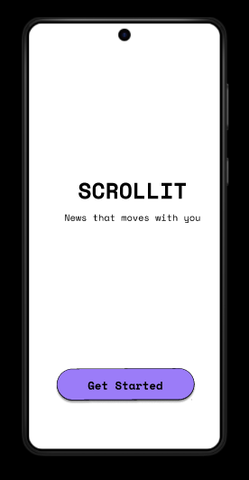
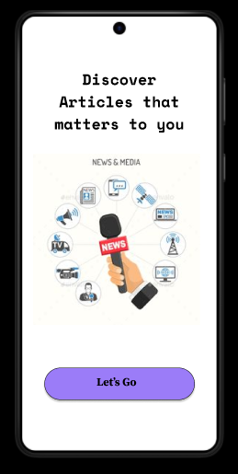
Results

Slide 17
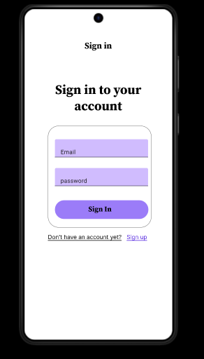
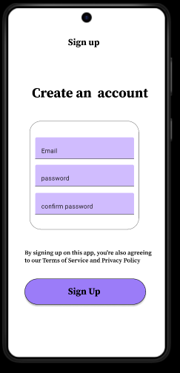
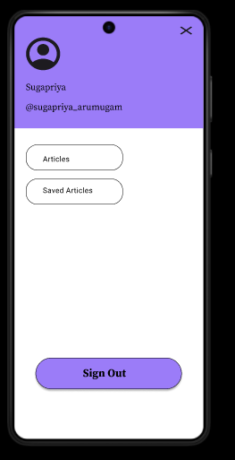
Results

Slide 18
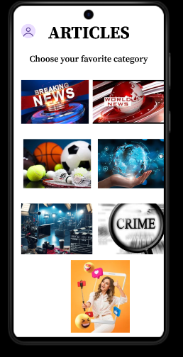
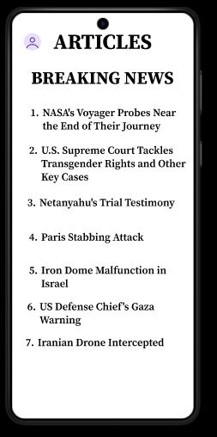
Results

Slide 19
Conclusion
The News Feed App represents a significant advancement in personalized news delivery. By integrating machine learning algorithms with design thinking principles, the app provides a seamless, engaging, and user-friendly experience. It not only addresses the challenge of information overload but also empowers users to stay informed on their own terms. Future enhancements include voice command features, multilingual support, and integration with wearable devices to make the app even more versatile and inclusive.

Slide 20
Thank You
Any queries???

